Slide 1
HEAP DATA STRUCTURE

Slide 2
A Heap is a special Tree-based data structure in which the tree is a complete binary tree. Generally, Heaps can be of two types:
Max-Heap: In a Max-Heap the key present at the root node must be greatest among the keys present at all of it’s children. The same property must be recursively true for all sub-trees in that Binary Tree.
Min-Heap: In a Min-Heap the key present at the root node must be minimum among the keys present at all of it’s children. The same property must be recursively true for all sub-trees in that Binary Tree.

Slide 3

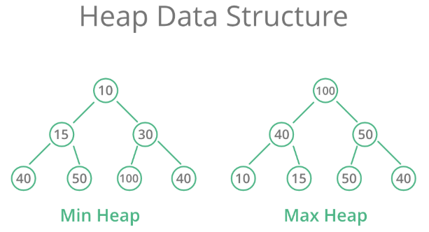

Slide 4
Binary Heap: Definition
Binary heap.
  Almost complete binary tree.
    filled on all levels, except last, where filled from left to right
  Min-heap ordered.
    every child greater than (or equal to) parent
06
14
45
78
18
47
53
83
91
81
77
84
99
64

Slide 5
Binary Heap: Properties
Properties.
  Min element is in root.
  Heap with N elements has height = ⎣log₂ N⎦.
06
N = 14
Height = 3
14
45
78
18
47
53
83
91
81
77
84
99
64

Slide 6
Binary Heaps: Array Implementation
Implementing binary heaps.
  Use an array: no need for explicit parent or child pointers.
    Parent(i) = ⎣i/2⎦
    Left(i) = 2i
    Right(i) = 2i + 1
06
1
14
45
2
3
78
18
47
53
4
5
6
7
83
91
81
77
84
99
64
8
9
10
11
12
13
14
Notes:
parent and children formula require only simple bit twiddling operations

Slide 7
Insertion in Heaps
Given a Binary Heap and a new element to be added to this Heap. The task is to insert the new element to the Heap maintaining the properties of Heap.
Process of Insertion: Elements can be inserted to the heap as
  First increase the heap size by 1, so that it can store the new element.
  Insert the new element at the end of the Heap.
  This newly inserted element may distort the properties of Heap for its parents. So, in order to keep the properties of Heap, heapify this newly inserted element following a bottom-up approach.

Slide 8
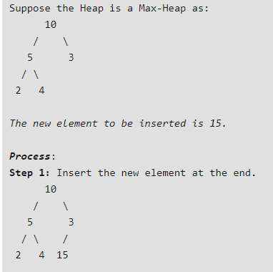

Slide 9
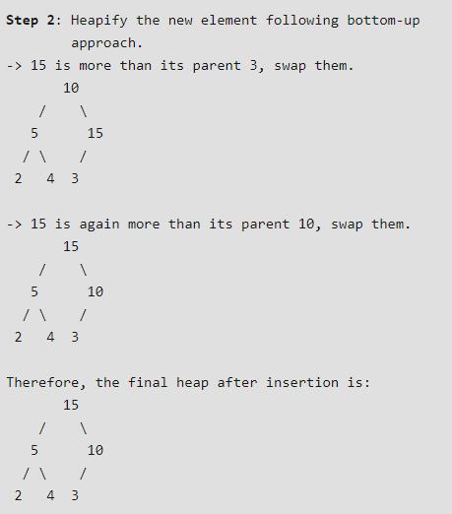

Slide 10
Binary Heap: Insertion
Insert element x into heap.
  Insert into next available slot.
  Bubble up until it's heap ordered.
    Peter principle: nodes rise to level of incompetence
06
14
45
78
18
47
53
83
91
81
77
84
99
64
42
next free slot

Slide 11
Binary Heap: Insertion
Insert element x into heap.
  Insert into next available slot.
  Bubble up until it's heap ordered.
    Peter principle: nodes rise to level of incompetence
swap with parent
06
14
45
78
18
47
53
83
91
81
77
84
99
64
42
42

Slide 12
Binary Heap: Insertion
Insert element x into heap.
  Insert into next available slot.
  Bubble up until it's heap ordered.
    Peter principle: nodes rise to level of incompetence
swap with parent
06
14
45
78
18
47
42
83
91
81
77
84
99
64
42
53

Slide 13
Binary Heap: Insertion
Insert element x into heap.
  Insert into next available slot.
  Bubble up until it's heap ordered.
    Peter principle: nodes rise to level of incompetence
  O(log N) operations.
stop: heap ordered
06
14
42
78
18
47
45
83
91
81
77
84
99
64
53

Slide 14
Construct a Min Heap using the following Numbers
44,33,77,11,55,88,66,22

Slide 15
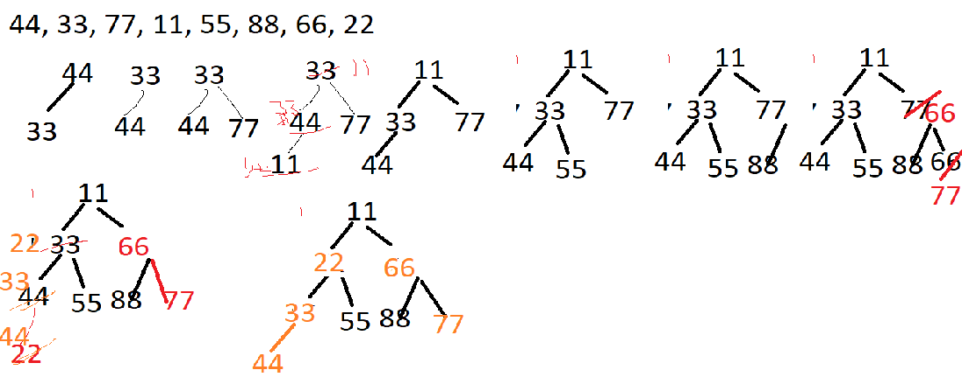

Slide 16
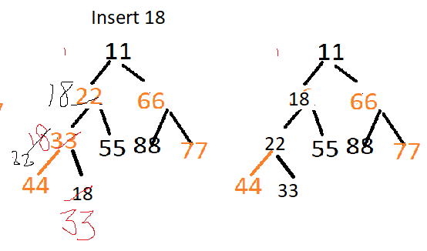
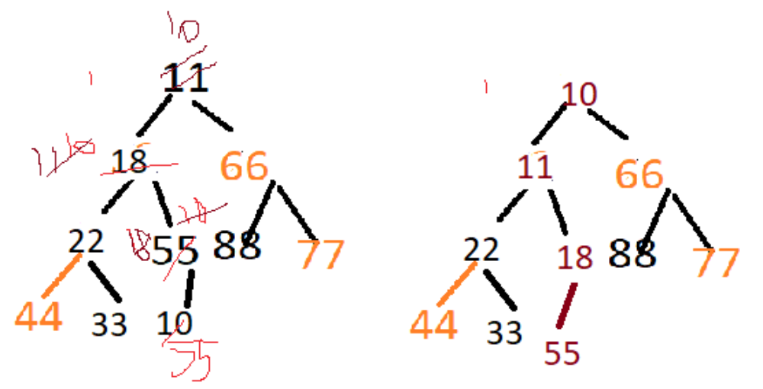
Insert 10

Slide 17
Insert Heap( tree, n, item )
{ n=n+1;
loc = n;
while ( loc >1)
{
parent = (floor) loc/2;
if ( item <= tree[parent])
{ tree[loc]=item; return;
}
tree[loc]=tree[parent]; // Bubble up
loc= parent;
}
tree[1]=item;
return;
}

Slide 18
Deletion in Heap
Given a Binary Heap and an element present in the given Heap. The task is to delete an element from this Heap.
The standard deletion operation on Heap is to delete the element present at the root node of the Heap.
That is if it is a Max Heap, the standard deletion operation will delete the maximum element and if it is a Min heap, it will delete the minimum element.

Slide 19
Process of Deletion:
Since deleting an element at any intermediary position in the heap can be costly, so we can simply replace the element to be deleted by the last element and delete the last element of the Heap.
Replace the root or element to be deleted by the last element.
Delete the last element from the Heap.
Since, the last element is now placed at the position of the root node. So, it may not follow the heap property. Therefore, heapify the last node placed at the position of root.

Slide 20
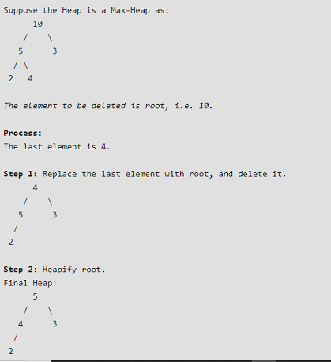

Slide 21
Binary Heap: Delete Min
Delete minimum element from heap.
  Exchange root with rightmost leaf.
  Push down until it's heap ordered.
    power struggle principle: better subordinate is promoted
06
14
42
78
18
47
45
83
91
81
77
84
99
64
53

Slide 22
Binary Heap: Delete Min
Delete minimum element from heap.
  Exchange root with rightmost leaf.
  Bubble root down until it's heap ordered.
    power struggle principle: better subordinate is promoted
53
14
42
78
18
47
45
83
91
81
77
84
99
64
06

Slide 23
Binary Heap: Delete Min
Delete minimum element from heap.
  Exchange root with rightmost leaf.
  Bubble root down until it's heap ordered.
    power struggle principle: better subordinate is promoted
exchange with left child
53
14
42
78
18
47
45
83
91
81
77
84
99
64

Slide 24
Binary Heap: Delete Min
Delete minimum element from heap.
  Exchange root with rightmost leaf.
  Bubble root down until it's heap ordered.
    power struggle principle: better subordinate is promoted
exchange with right child
14
53
42
78
18
47
45
83
91
81
77
84
99
64

Slide 25
Binary Heap: Delete Min
Delete minimum element from heap.
  Exchange root with rightmost leaf.
  Bubble root down until it's heap ordered.
    power struggle principle: better subordinate is promoted
  O(log N) operations.
stop: heap ordered
14
18
42
78
53
47
45
83
91
81
77
84
99
64

Slide 26
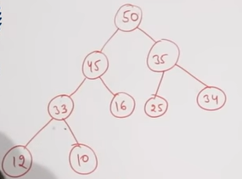
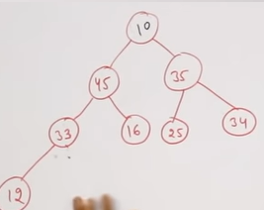
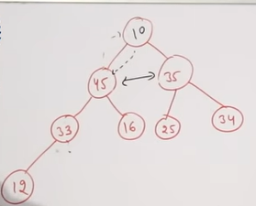
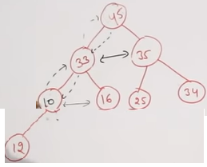
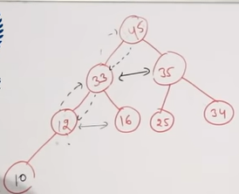

Slide 27
Binary Heap: Heapsort
Heapsort.
  Insert N items into binary heap.
  Perform N delete-min operations.
  O(N log N) sort.
  No extra storage.

Slide 28
Maxheapify(A,n,i)
{
int largerst=i;
int left = (2*i);
int right= (2*i)+1;
while(left<=n && A[left]>A[largest])
largest = left;
while ( right<=n && A[right]>A[largest])
largest= right;
if ( largest != i )
{ swap ( A[largest],A[i]);
Maxheapify(A, n, largest);
}
}
n
2n
2n+1

Slide 29
Heapsort (A,n)
{
for( i=n/2;i>=1;i--) // Build Maxheap
Maxheapify (A,n,i)
for (i=n; i>1; i--) // Delete
{
swap( A[1], A[i])
Maxheapify(A,n, 1)
}

Slide 30
Time complexity of Insertion in Heap and Deletion in Heap is
O(nlogn)

